Slide 1
Final Presentation : Gofundme
Alban d’Hauthuille, Victor Bakache, Manon Krook, Thomas Lance

Slide 2
Outline
What is Gofundme ?
Crowdfunding platforms
Why did we chose GoFundme
Webscraping strategy
Overall structure of the website
Using BeautifulSoup
Using Selenium
Final Data Collection
Data Analysis
Overall information
Linear Regressions
Conclusion

Slide 3
What is crowdfunding ?

Slide 4
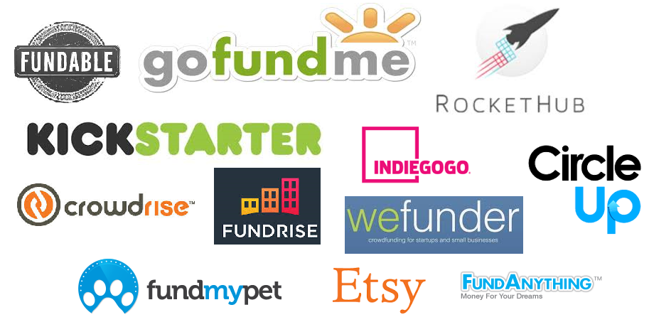
Crowdfunding platforms
“The practice of funding a project or venture by raising money from a large number of people who each contribute a relatively small amount, typically via the internet.”

Slide 5

Gofundme
Best platform for individuals
9 billions $ raised through 120 millions donations since 2010
The only 0% platform fee
No limits of amount nor deadlines
18 categories of project
Professional and personal projects

Slide 6
Webscraping strategy

Slide 7
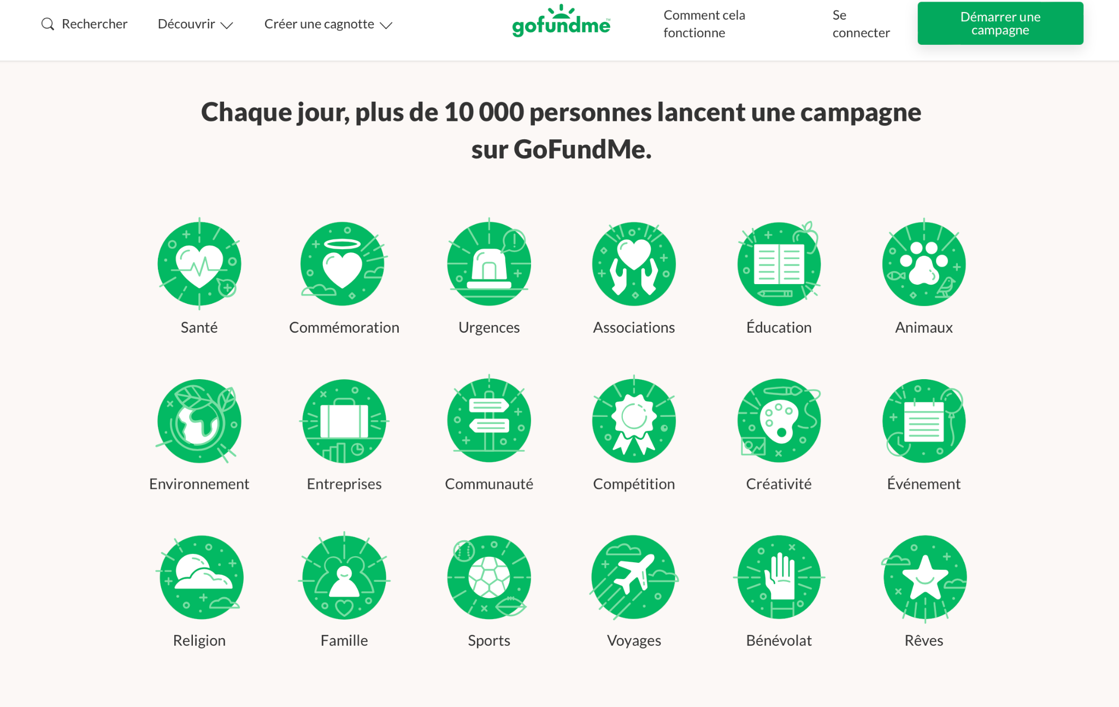
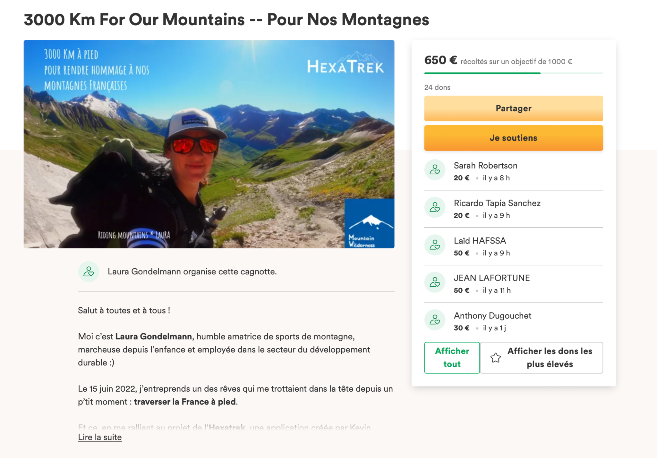
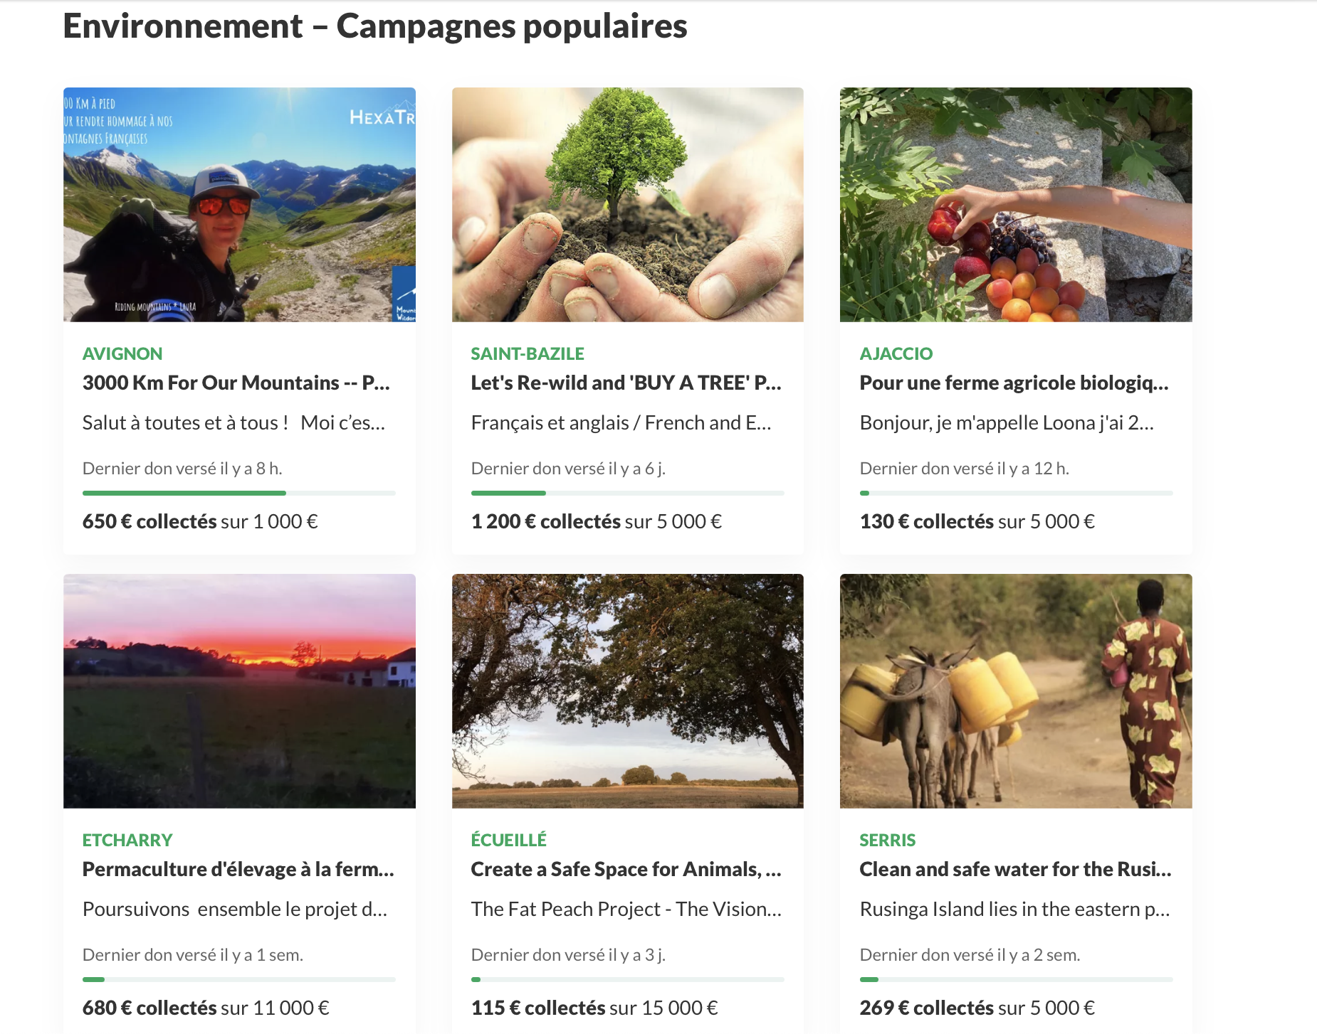
Overall Structure of the website

Slide 8
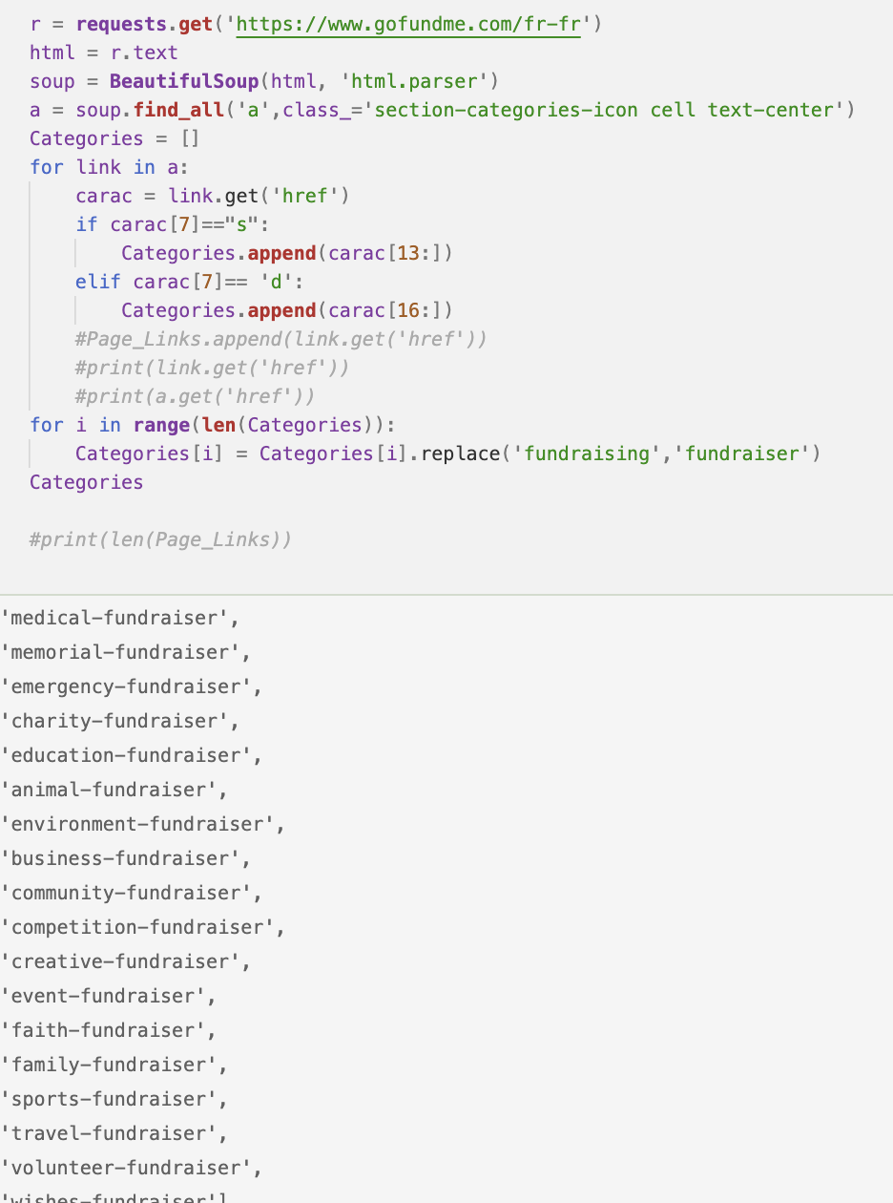
Using BeautifulSoup
Which data did we scrap ?
Name
Creation date
Amount asked
Amount raised
Category of each project
number of donors
Description of each project
Town location

Slide 9
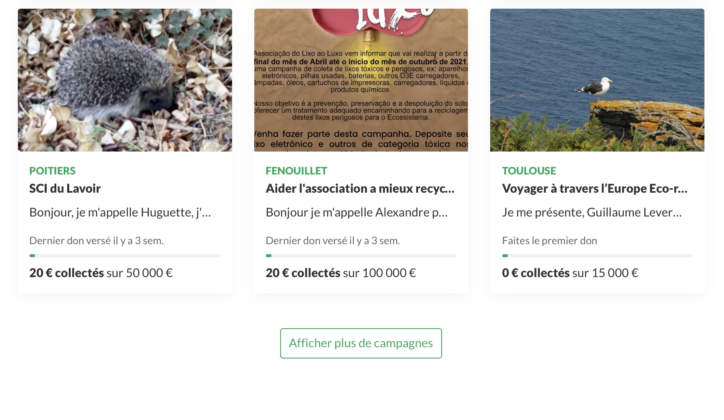
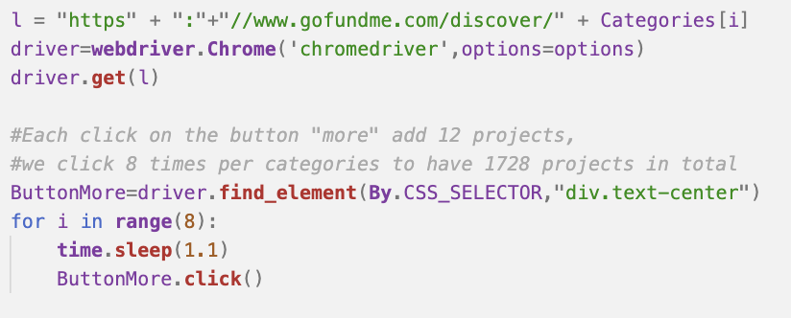
Using Selenium
Main Issue : Loading more projects doesn’t lead to a new html page
Using Selenium enables to click on this loading button

Slide 10
Data Analysis

Slide 11
Cleaning data :
Transform Creation Date to datetime
Convert to proper type (string → integers)
Tokenize description of projects and keep words with more than 4 letters
Creation of the ‘Mean Donation column’
Drop useless columns
Drop the 5% highest values for each category (avoid fake projects)

Slide 12
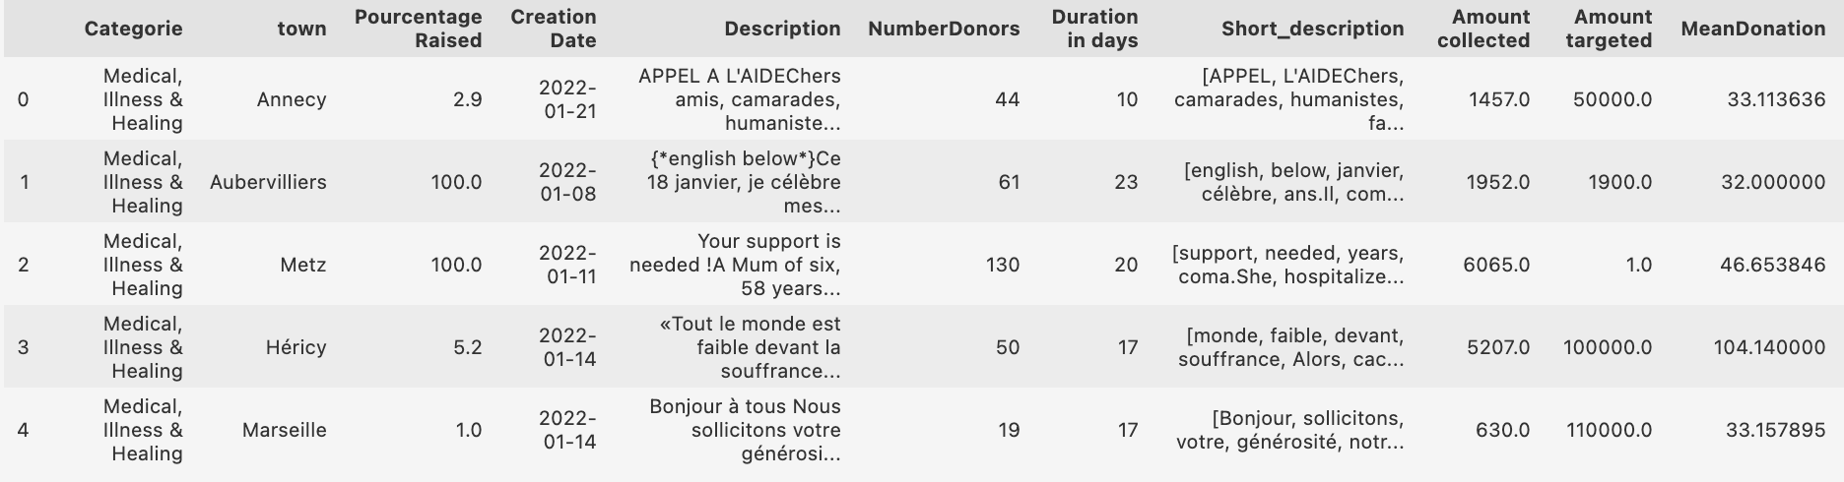
Final DataFrame
Using Pandas
Figure 1: Head of the final dataframe

Slide 13
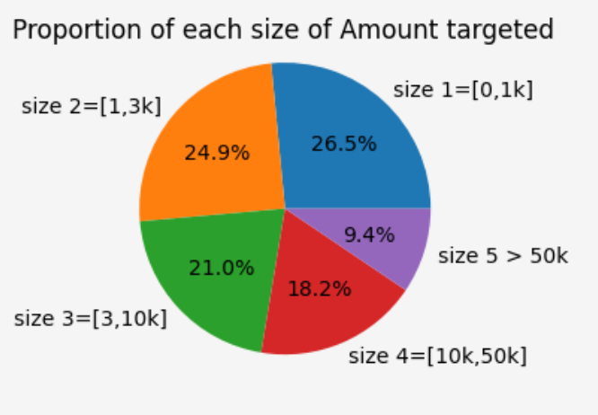
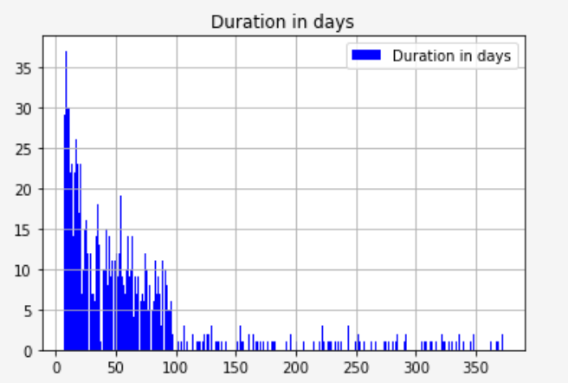
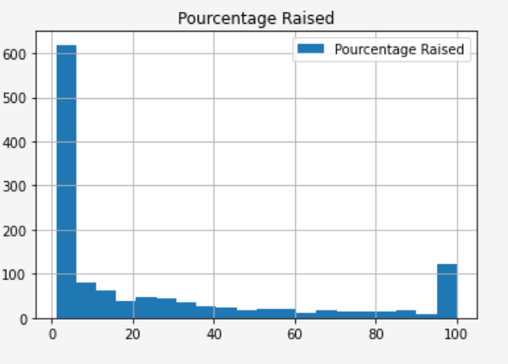
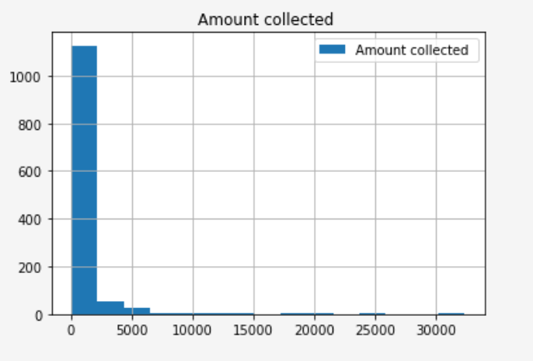
Overall information
Figure 5: Distribution of amount targeted
Figure 2: Distribution of duration days
Figure 4: Distribution of pourcentage raised
Figure 3: Distribution of amount collected

Slide 14
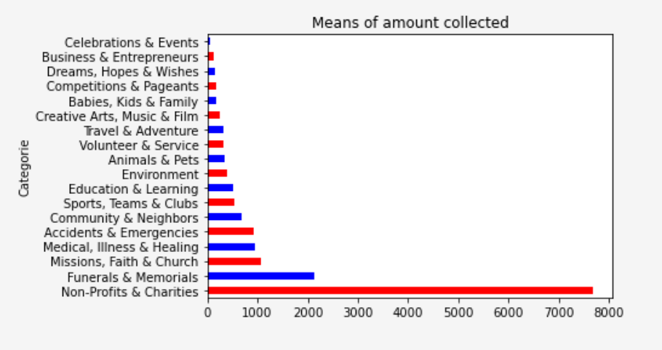
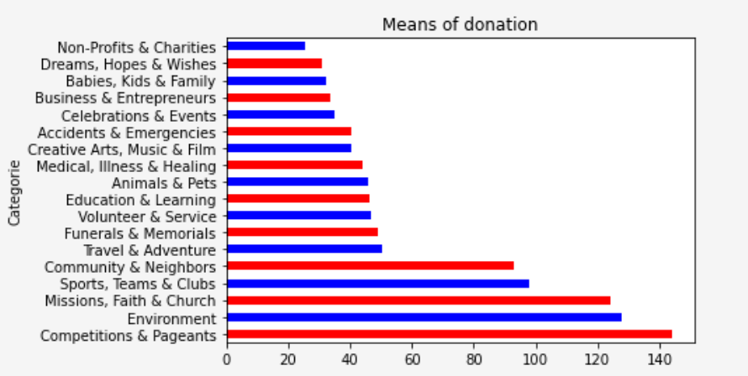
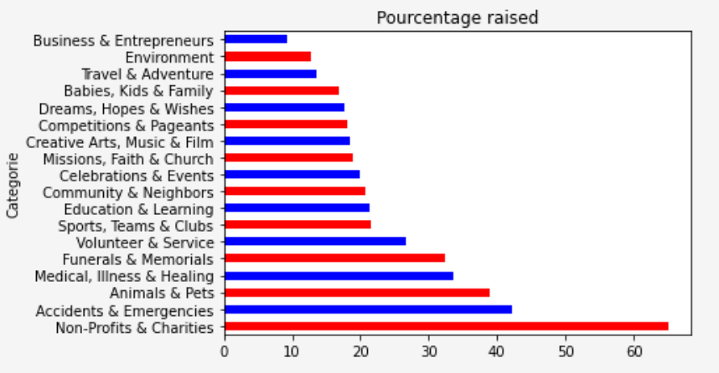
Information group by category
Figure 6: mean donation (€) by category
Figure 8: mean amount collected (€) by category
Figure 7: Mean pourcentage raised by category

Slide 15
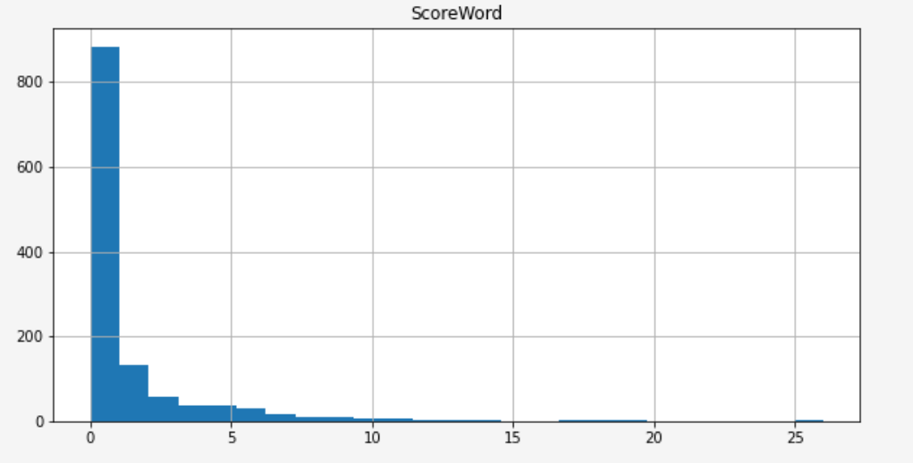
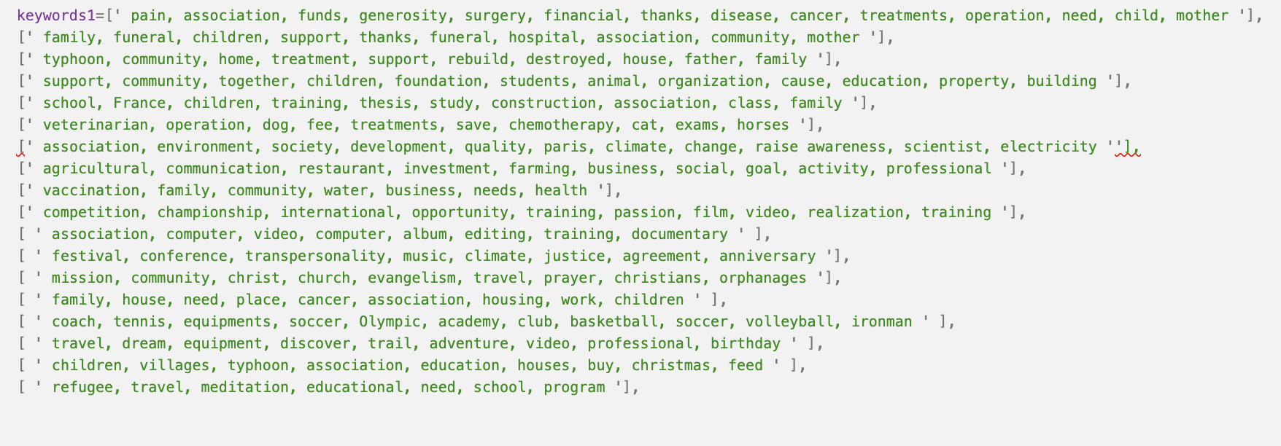
Implementing keywords in description
Figure 9: List of keywords relevant by category
Figure 10 : Distribution of number of keywords

Slide 16
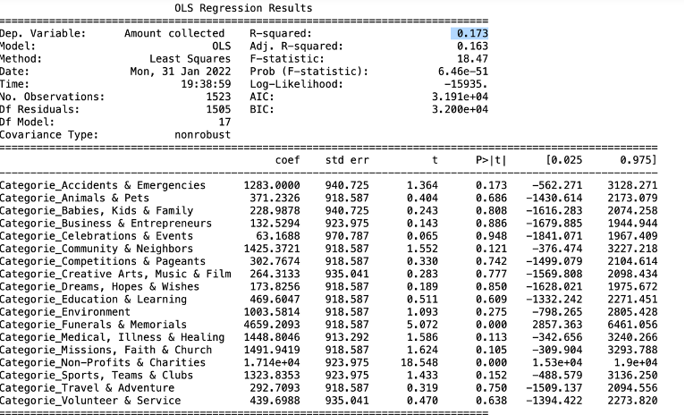
Linear regression: Category influence
Figure 11: OLS results showing the category influence on amount raised

Slide 17
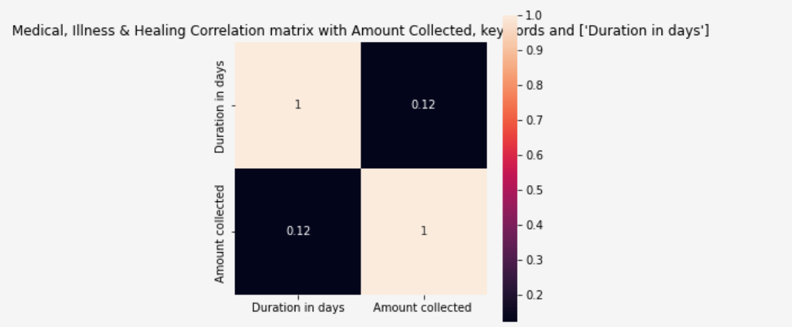
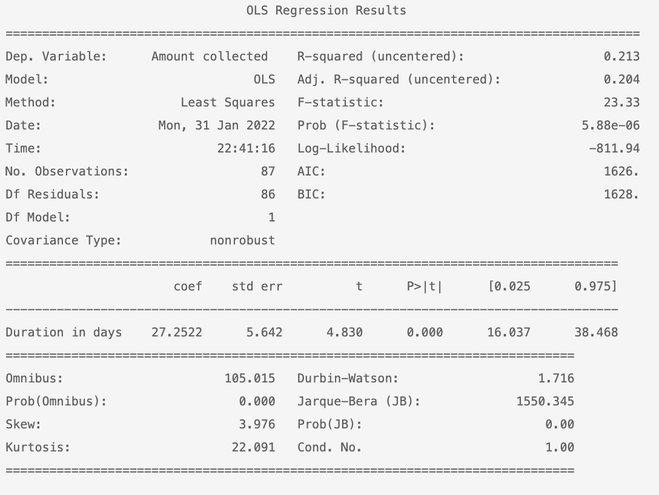
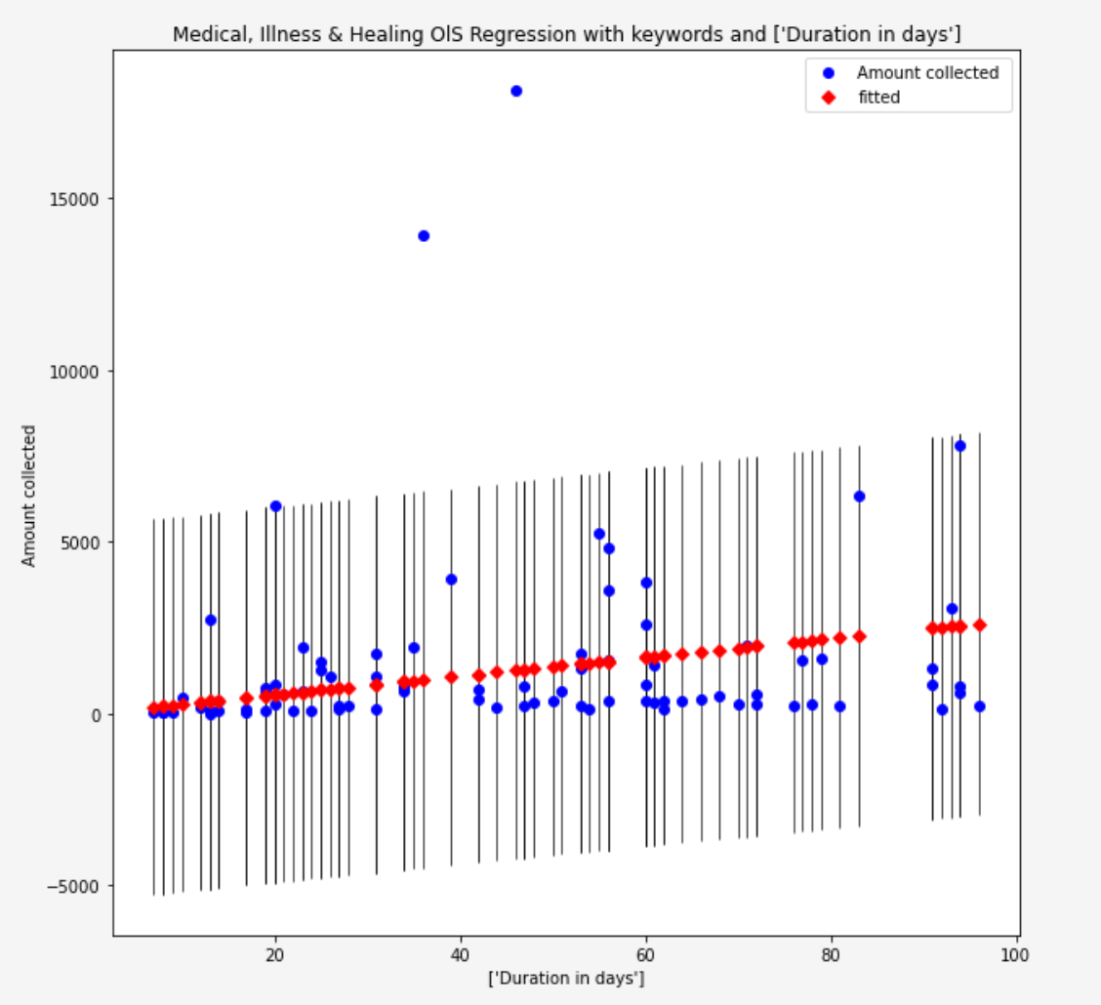
Linear regression: influence of Score Word
Figure 14: Correlation matrix for the OLS
Figure 12: OLS results showing how the score word influence on amount raised
Figure 13: Plot of the OLS, selecting Medical category

Slide 18
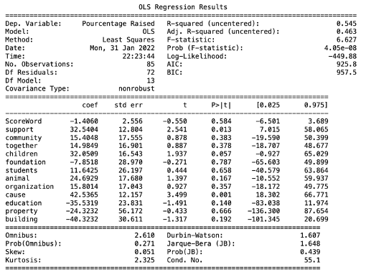
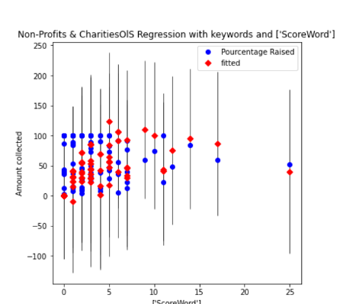
Linear regression: influence of Score Word and keywords
Figure 15: OLS results showing how the score word and each key words of ‘Non-profit ’ influence on amount raised
Figure 16: Plot of the OLS

Slide 19
Conclusion
Factors that have an influence on the foundation of a project
Description of the project
The category of a project
External effects (famous people, solidarity association)
Factors that don’t have an influence on the foundation of a project:
Location of a project

Slide 20
Thank you for your time
Any questions ?

